Slide 1
Objectives | Key Results
Name of course here
Template

Slide 2
Company Objective
Objectives | Key Results
The Objectives and Key Results that we set for 2019 is to ultimately increase departmental productivity and test and implement new growth strategies that can increase our annual revenue by 50 percent or more.

Slide 3
Advantages of OKRs
Objectives | Key Results
Alignment
Empowerment
Connect individual and team performance back to shared company objectives so that everyone movies in the same direction.
Increased visibility gives everyone the context they need to make the best decision and shows the employee the impact of their work.
Prioritization
Measurement
The 3-5 objectives for each level of an organization forces us to what will have the greatest impact on the company.
2017 | 35 %
Illustrate how far along individuals, teams and the overall company are in accomplishing the shared company mission.
2018 | 40 %
2019 | 50 %
Transparency
2020 | 65 %
Accomplishment
2021 | 85 %
Enable us to have a transparent culture, as everyone knows how each team and individual is planning to make an impact.
OKRs are meant to be stretched - just beyond the threshold of what seems possible - so we can achieve remarkable results.

Slide 4
Objectives | Key Results
Operational KR
Aspirational KR
Text 1
Text 4
Text 3
Text 3
Text 2
Text 2
Text 1
Text 1
-1 2 3 5 7 9 11 13 15
-1 2 3 5 7 9 11 13 15
1300
in revenue
1500
in revenue
Operational Key Results use a 70-100% success threshold for targets, any score under 100% would be deemed a failure. They are to be achieved in full within the set time frame
Aspirational Key Results fail at an average rate of 40%, meaning 60% completion. Aspirational KRs are typically set at 60-70% while encouraging employees to aim high.

Slide 5
Quarterly Company Objectives
Objectives | Key Results
Quarter 1
Quarter 2
Quarter 3
Quarter 4
Our main company objective set for Quarter One is to Increase recurring revenues by 30%.
Our company objective for Quarter Two is to launch version 2 of one of our main products.
Our company objective for Quarter Three is to raise $2m for our growth needs.
Our objective for Quarter Four is to achieve revenue by 50% and profitability by 30%.

Slide 6
KRs for Quarterly Objectives
Objectives | Key Results
Increase revenue by 50%
Quarter 1 KRs
Quarter 2 KRs
Quarter 3 KRs
Quarter 4 KRs
Increase annual renewals to 75%
Get over 10000
new signups
Email and phone outreach to 100 VCs and seed funds
Hit quarterly revenue of $450k
Reduce churn to less than 5%/mo
Achieve signup to % trial ratio of 45%
Increase gross profit margin from 30% to 39%
Get at least 30 second contact meetings or calls
Reach monthly recurring revenue of 100k
Achieve trial to % paid ratio of over 50%
Start sales in 2 new domestic markets
Solicit 3 term sheets of our minimum required terms
Decrease one-time
contracts sold by 15%
Get published product reviews in over 15 publications
Start sales in 2 new domestic markets
Close an investment round with $2m pre-money

Slide 7
Organizational Approach
Objectives | Key Results
Strategy
Execution
Ultimate OKR
Company OKRs
Group OKRs
Initiatives
An ultimate goal to be achieved in the future. An Objective sets a clear direction and provides motivation. An Objective can be thought of like a destination on a map.
A company-wide goal to be achieved in the future. An Objective sets a clear direction and provides motivation. An Objective can be thought of like a destination on a map.
A Group Key Result is a metric with a starting value and a target value that measures progress towards an Objective. A Key Result is like a signpost with a distance that shows how close you are to your Objective.
An Initiative is a description of the work you’ll do to influence a Key Result. If an Objective is your destination and a Key Result shows the distance to go, an Initiative describes what you’ll do to get there, (take a car, row a boat, etc.).

Slide 8
Departmental OKR Progress
Objectives | Key Results
Product Development
Sales
Marketing
Administrative & Operations
Technology & Engineering
50% Completion
55% Completion
37% Completion
78% Completion
60% Completion

Slide 9
Product Development Group Objectives
Objectives | Key Results
Quarter 1 Objective
Q1
Implement new 360-degree product planning process
Quarter 2 Objective
Q2
Research, analyze & understand what our users and non-users really think
Quarter 3 Objective
Q3
Successfully launch version 3 of our main product
Q4
Quarter 4 Objective
Activate user-testing of our product

Slide 10
Product Development Q1 Key Results
Objectives | Key Results
Document clear role division between sales, marketing, design and development
25%
Integrate user testing into all activities in product planning and design phase
35%
Integrate user testing into pre-launch testing phase
45%
Decide on and document the process of input methods to and from sales, marketing, design and development back into product management
25%

Slide 11
Performance Dashboard
Objectives | Key Results
Team A Average
02
Months left in Q1
Our Team Average
Team C Average
19
Days left in Q1
Team D Average
Employee Name
Operational KR
Progress
Aspirational KR
Progress
On Track
Bob Smith
Bob Smith’s KR for Q1 is this
80%
Bob Smith’s KR for Q1 is this
60%
Y
John Smith
John Smith’s KR for Q1 is this
35%
John Smith’s KR for Q1 is this
25%
N
Joe Smith
Joe Smith’s KR for Q1 is this
50%
Joe Smith’s KR for Q1 is this
35%
N
Tom Smith
Tom Smith’s KR for Q1 is this
60%
Tom Smith’s KR for Q1 is this
45%
N
x
Dan Smith
Dan Smith’s KR for Q1 is this
80%
Dan Smith’s KR for Q1 is this
70%
Y

Slide 12
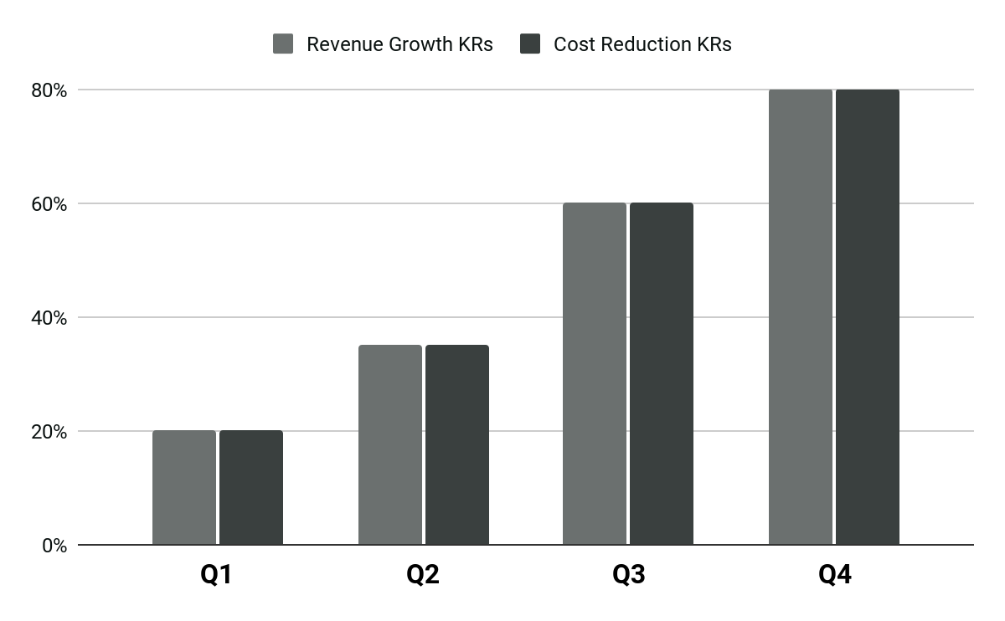
Revenue Growth KRs vs. Cost Reduction KRs
Objectives | Key Results

Slide 13
Best Practices of OKR Setting
Objectives | Key Results
Objectives
Key Results
Practices
O
B
J
E
C
T
Objective
Bracing
Judicious
Exact
Clear
Tangible
R
E
S
U
L
T
Reachable
Exponent
Significant
Understandable
Limited to numbers
Trackable
3-4 Objectives max per level (e.g. per person
3-5 Key Results max per Objective
If Write for other people: they must clearly understand your goals

Slide 14
Human Resources Q1 OKR
Objectives | Key Results
2019 Q1 Key Results
2018 Q1
2019 Q1
Interview 48 employees on their needs for improving our work culture.
60%
Implement using OKRs and Weekdone software in all 23 teams
90%
Reach weekly employee satisfaction score of at least 4.7 points
Objective: Improve internal employee engagement and job satisfaction
65%
Conduct 3 monthly “Fun Friday” all-hands meetings with motivational speakers
45%

Slide 15
Engineering Q1 OKR
Objectives | Key Results
2019 Q1 Key Results
2018 Q1
2019 Q1
Survey 5 external API users regarding issues with our authentication
35%
Discuss the user management code usage with 5 engineers having used it in production
80%
Rewrite and launch new version of our user management module
Objective: Refactor our old user management module
50%
Rewrite the API user authentication for new version
65%

Slide 16
Management Q1 OKR
Objectives | Key Results
2019 Q1 Key Results
2018 Q1
2019 Q1
Everyone keeps their forms up to date at all times
55%
People give regular feedback to others weekly
30%
Get well acquainted with & configure Weekdone
Objective: Implement regular usage of OKRs and Weekdone
80%
Conduct an all-hands team meeting to introduce OKRs and Weekdone software
75%

Slide 17
Operations Q1 OKR
Objectives | Key Results
Key Result
Key Result
Key Result
Objective
60%
35%
75%
56%
+
+
=
Implement a better system for tracking incoming requests
Review software options for incoming document tracking
Start compiling a weekly “Office Highlights” newsletter to all team members
Improve our document and information management procedures

Slide 18
Marketing Q1 OKR
Objectives | Key Results
Key Result
Key Result
Key Result
Objective
50%
83%
100%
77%
+
+
=
Implement 12 new channels/mediums where to post old or new content
60 marketing takeaways by reading 1h of marketing materials a day
1 test from a product review site for paid promotion
Improve our content and its distribution

Slide 19
Finance & Accounting Q1 OKR
Objectives | Key Results
Key Result
Key Result
Key Result
Objective
85%
60%
0%
48%
+
+
=
Conduct a day-long planning session with each division manager
Review software options for incoming document tracking
Receive business line budget proposals before Sept 1st
Improve annual budgeting and business planning

Slide 20
Sales Q1 OKR
Objectives | Key Results
Key Result
Key Result
Key Result
Objective
30%
40%
85%
61%
+
+
=
Make sure at least 50% of signups % called back in first 24 hours
Have all salespeople listen in to at least 10 product demos of other team members
Create a best practices sales process document with minimum allowed service levels
Increase the quality of our sales approach

Slide 21
Demand Generation OKRs
Objectives | Key Results
Generate more Marketing Qualified Leads (MQLs) | Optimize our Customer Acquisition | Implement Account Based Marketing
Generate 150 MQLs from email marketing Generate 100 MQLs from AdWords Generate 50 MQLs from organic search Generate Net-New Unique leads via Account-Based Marketing | Improve our new marketing automation process Reduce the Customer Acquisition Costs by 20% in Q3 Build a new tops-down and bottoms-up Excel model to analyze the ROI | Document and implement the new ABM process Do 2 weekly alignment meetings with the SDR team Do 1 weekly alignment meeting with SDR team managers Generate 20% of closed-won sales via ABM efforts in Q4

Slide 22
Online Marketing OKRs
Objectives | Key Results
Improve our website and increase the conversions | Improve our PPC Campaign | Implement Account Based Marketing
Grow website visitors by 7% every month Improve conversions on Landing Pages by 10% in Q2 | Get 150 MQLs from Google AdWords Ensure a Cost per Lead of $4 or less Ensure a 2% CTR | Get 10 new inbound links from relevant websites Improve our internal on-page optimization Improve our website loading speed

Slide 23
Content Marketing OKRs
Objectives | Key Results
Launch the new Monthly Newsletter successfully | Improve our Blog Strategy
Publish 3 new newsletters this quarter Finalize our new monthly newsletter Ensure we get a 3% CTR or above | Publish 50 new blog posts in Q3 Do 5 VIP interviews of industry experts Get 5,000 subscribers on our blog

Slide 24
PR/Analyst Relations OKRs
Objectives | Key Results
Increase our Brand Awareness | Build Strong Relationships with Jane & Doe
Have 30 media calls/meetings by end of Q1 Have 15 calls/meetings with key industry influencers Secure a speaking spot at the Annual Industry conference | Do 2 analyst briefings in Q1 Submit analyst report applications Feature an analyst on our webinar Provide analysts with details on the new product launch

Slide 25
Sales Group OKRs
Objectives | Key Results
Generate new bookings pipeline | Recruit world-class A-Players for our sales team | Develop our reps into the best sales team in the industry
Generate inflow of $12M in pipeline Keep pipeline above 5x of quota to ensure a 20% Win Rate Do 7 product demos per week | Hire 10 new AEs by the end of January Hire 20 new SDRs by the end of January Hire 5 new Sales Managers by the end of January Maintain a 4:1 onsite “Interview : Offer” ratio | Implement a better onboarding process Ensure we do regular sales coaching every week Bring in the new sales training company to improve our training Do regular monthly anonymous surveys of SDRs and AEs and get their feedback

Slide 26
SDR Manager OKRs
Objectives | Key Results
Grow our upsell and cross-sell | Implement SDR Social Selling Process | Exceed our Q4 Quotas by 50%
Promote 3 SDRs to the upsell AE role Increase upsell and cross-sell revenue by 40% Increase customer retention to 98% Have regular weekly alignment meetings with Customer Success | Pass SQL’s to sales executives Train 5 SDRs on social selling practices | Generate 80 Sales Qualified Leads Bring in $50,000 in bookings by end of Q3

Slide 27
Community Management KRs
Objectives | Key Results
Launch a new customer community | Make community known by industry experts and leaders
Create a Customer Community Strategy based on best practices Publish 60 articles during the quarter and get 6,000+ page visits Get 30% of our customers to participate in the community | Reach out to 12 industry experts and thought leaders in Q1 Interview them and publish the interview articles on our community site Research and publish the Industry Report & Infographics for the community

Slide 28
Sales Enablement KRs
Objectives | Key Results
Enable our sales to be more successful | Improve our Sales Analytics Process
Ensure we update our new sales technology stack Revise all the email sequences and upload it into the new sales messaging tool Update the CRM based on the new sales pipeline review process Help the VP of Sales with the new data to finalize the new compensation plan | Implement a sales analytics and Business Intelligence platform Set up sales cycle and average deal size triggers to email our VP of Sales Review Sales Activity metrics and send a weekly summary to the team Review Sales Pipeline metrics and send a weekly summary to the team

Slide 29
People Operations OKRs
Objectives | Key Results
Create an exceptional corporate culture | Improve our employee retention | Grow our team with A-Players
Launch an ongoing 2-way closed-loop feedback process Create clarity of all departments and teams via clear OKR goals Achieve a weekly Employee Satisfaction / Pulse Score of 8+ Celebrate “small wins” and any type of progress every single week CEO and SVPs to launch a monthly Town Hall with Open Q&A | Improve our 2-way closed-loop feedback and ongoing performance management process Improve our employee engagement score and employee satisfaction to 8 or above Survey employees monthly on how to make our company an even better place to work Assess if we are paying salaries and benefits at market rates | Offer our employees a $500 reward for referrals of A-Players whom we hire Hire 25 new employees this quarter for the 5 requesting departments Survey interviewees after each interview process and get feedback Maintain a 4:1 Interview-to-hire ratio

Slide 30
People Operations OKRs
Objectives | Key Results
Improve our employee engagement score | Make all of our managers more effective and successful | Transition to ongoing performance management
Ensure every manager company-wide is doing an ongoing, 2-way feedback loop Survey employees with using a Pulse (Employee Satisfaction Index) weekly Ensure we are setting clarity of work with goals to boost engagement | Provide consistent training to managers on how to manage effectively Ensure every manager is doing regular 1-on-1 meetings with 2-way feedback Do monthly anonymous employee surveys to get feedback on managerial effectiveness | Announce the transition from outdated annual performance review process Implement the ongoing 2-way closed-loop feedback with lite check-ins Institute quarterly performance reviews Announce new annual reviews to serve as a summary for the ongoing process

Slide 31
Product Management OKRs
Objectives | Key Results
Launch the new product successfully | Develop a new production vision for 2020
Conduct 30 customer development interviews Review 10 usage videos via UserTesting.com and summarize it internally Do 2 training sessions on the new product for Marketing and Sales teams Help Product Marketing by reviewing their technical spec documents | Interview 50 prospective customers and get their feedback Finalize the UX mockups and show it to 20 of those customers Discuss the summary findings with the sales team and get their input

Slide 32
Finance OKRs
Objectives | Key Results
Improve our annual budgeting process | Improve our financial reporting process
Have a meeting with every VP about the new process Review everyone’s budget proposals before mid-Q3 Finalize the final budget by Sep 15 | Hire a new bookkeeper Implement the cloud-based version of QuickBooks Ensure we close our financials within 2 weeks of a quarter

